Slide 1
One Night Stay Following Total Joint Surgery
Michael R. Pagnotto, MD
Tri-State Orthopaedics & Sports Medicine Inc.
9th Bone and Joint Health Series
August 9, 2017

Slide 2
Disclosure
There are no conflicts of interest pertaining to the material in this talk.

Slide 3
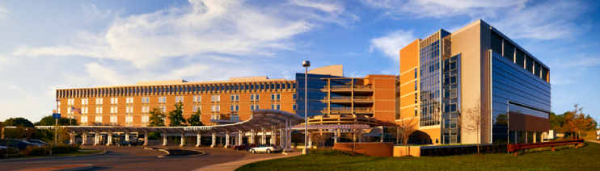
Michael R. Pagnotto, MD
North Allegheny Graduate
Princeton University - Chemical Engineering
Columbia University College of Physicians and Surgeons
Residency – University of Pittsburgh
Fellowship – Adult Reconstruction – Mayo Clinic
Tri-State Orthopaedics & Sports Medicine – 2011
UPMC Passavant

Slide 4
Short stay = 1 night
Why do we do it
How do we do it
Is it safe to do it

Slide 5
Why
Hospital
Insurance
Patient
Surgeon

Slide 6
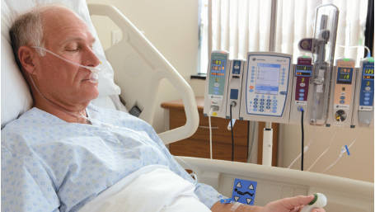
Patients
Younger
Healthier
More active
Better informed
Baby Boomers
1946-1964
55 – 73 year olds
The old view

Slide 7
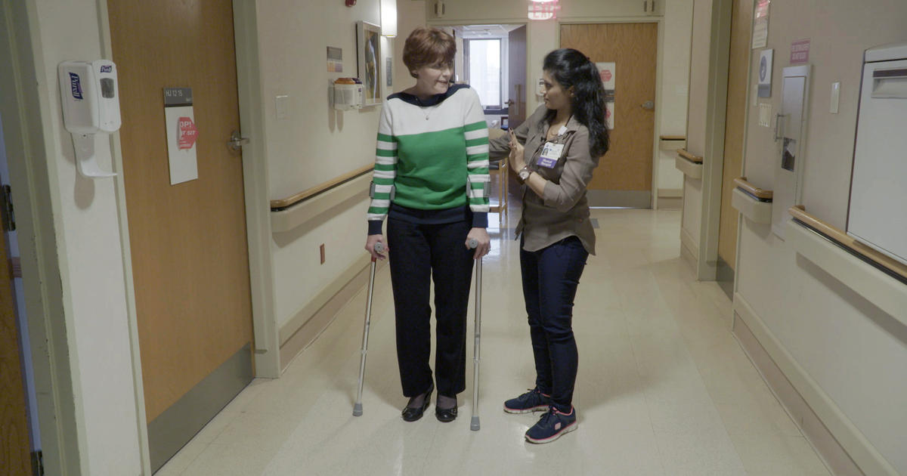
Patients
Younger
Healthier
More active
Better informed
Baby Boomers
1946-1964
55 – 73 year olds
The new expectation

Slide 8
Hospitals and Insurance
Volume of primary and revision total joint replacement in U.S. projected to grow by triple digits – AAOS 2018 Annual Meeting
By 2030 primary THR is projected to grow 171 percent and primary TKR is projected to grow by up to 189 percent, for a projected 635,000 and 1.28 million procedures, respectively
By 2060, primary THR is expected to reach 1.23 million (330 percent increase), primary TKR is expected to reach 2.60 million (382 percent increase)
The mean age for primary total hips has declined significantly from 66.3 years to 64.9 and knees from 68 years to 65.9

Slide 9
Surgeons
Patient satisfaction
Hospital administrators are happy
Insurance carriers are satisfied
Surgeons don’t like to round
Necessary progress to continue doing what we love
2030 - 2 Million Joint Replacements

Slide 10

How do we do it?
It’s not me it’s YOU!
95 % Team
5 % Surgical technique

Slide 11
Pre-op
Patient selection
  No firm cutoff for age
  Family / friend support is most important
Optimization
  BMI < 40
  Smoking cessation x 6 weeks
  Glycemic control
  Nutrition
  Vitamin D
  Anemia

Slide 12
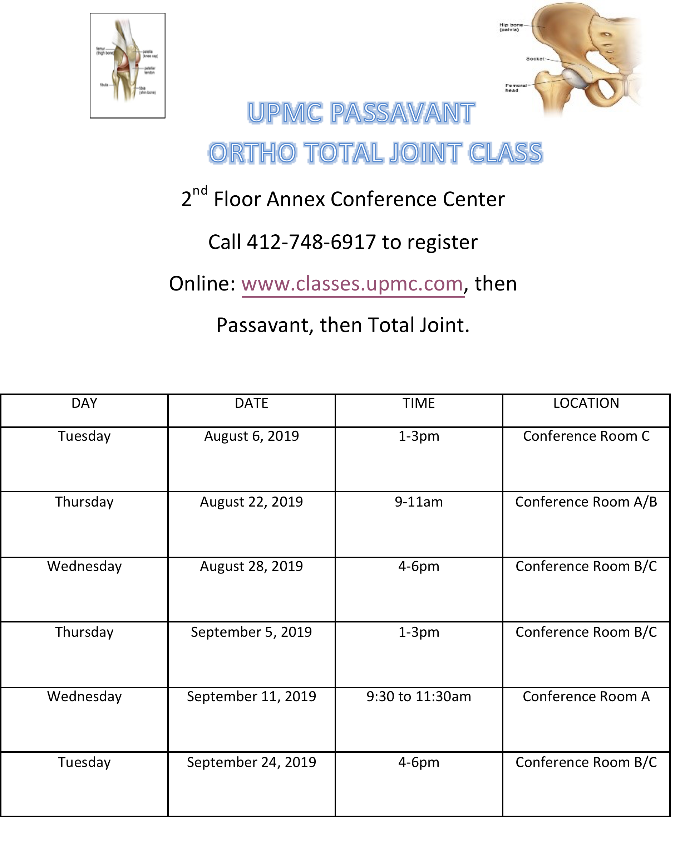
Pre-op
Preoperative Education
  Office
  Hospital
Prehab physical therapy

Slide 13

Day of surgery
Anesthesia support
  Enhanced recovery after surgery (ERAS)
  Multimodal pain management
  Selective nerve blocks
  Antiemetic
PACU support
Physical Therapy
  Early mobilization
  Education

Slide 14
ERAS
    Gatorade up to 3 hours prior to surgery
    Pre-op medications

Slide 15
Post-op Multimodal Pain
    Standing acetaminophen
    Standing gabapentin
    Standing Celecoxib
    Standing aspirin

Slide 16
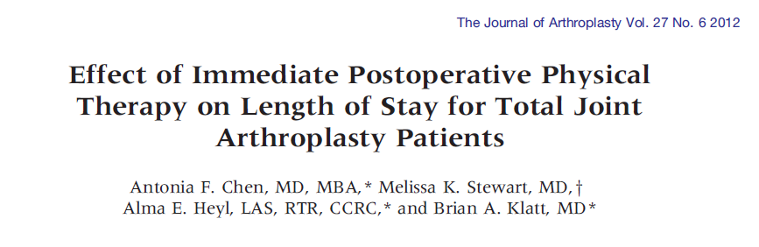
Same Day Physical Therapy
    POD 0 PT - LOS 2.8 days
    POD 1 PT - LOS 3.7 days

Slide 17
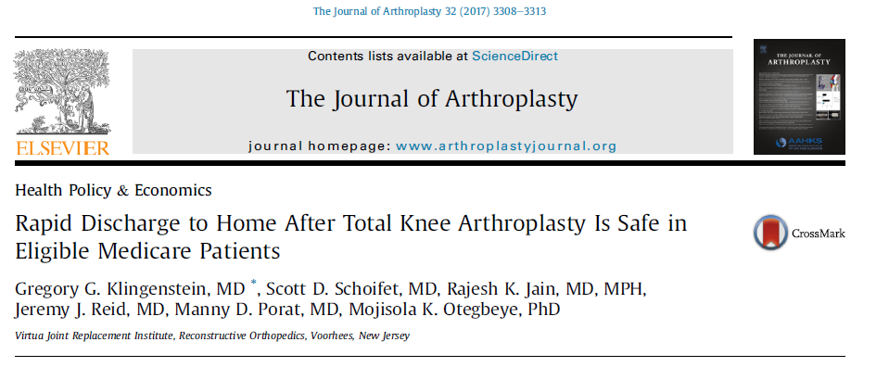
Is it safe?
    2287 Medicare patients TKA
    Compared short stay vs all others
    30 day readmission rate 1.1% vs 2.7%
    90 day readmission rate 1.7% vs 3.6%

Slide 18
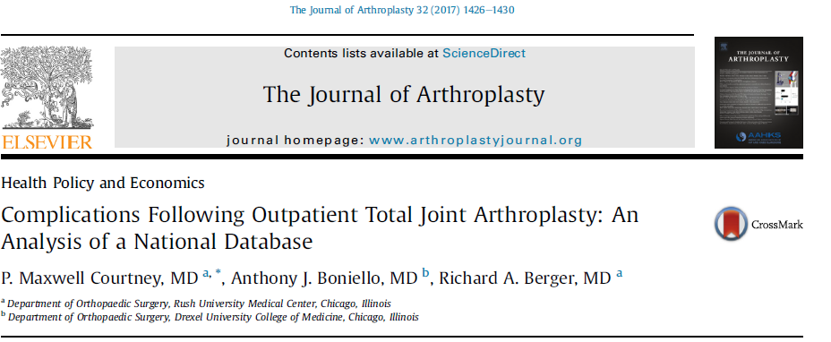
Is it safe?
    American College of Surgeons-National Surgical Quality Improvement Program
    169,406 patients TJA
    1220 outpatient (0.7%)
    Outpatient overall complication rate 8%
    Inpatient overall complication rate 16%

Slide 19
UPMC Passavant
TKA ALOS (Days)
  2017 3.01
  2018 2.37
  2019 2.19
THA ALOS (Days)
  2017 2.49
  2018 2.04
  2019 1.77
Pagnotto
TKA % Short stay
  2018 47 %
  2019 59 %
THA % Short stay
  2018 63 %
  2019 66 %

Slide 20
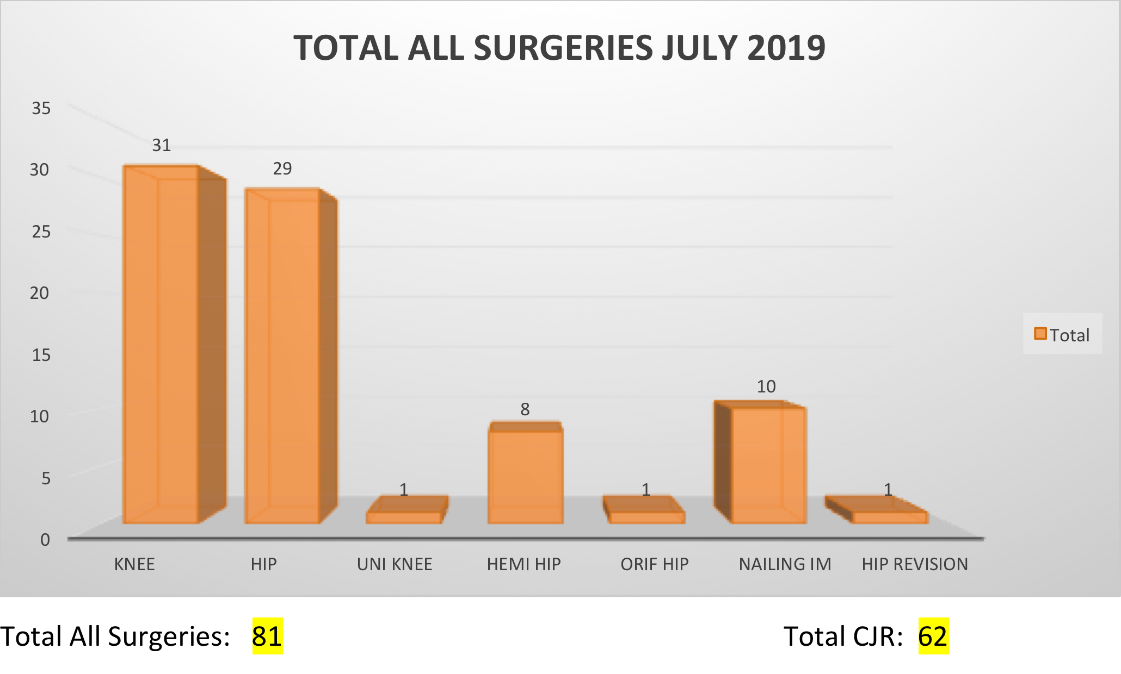
Passavant July 2019

Slide 21
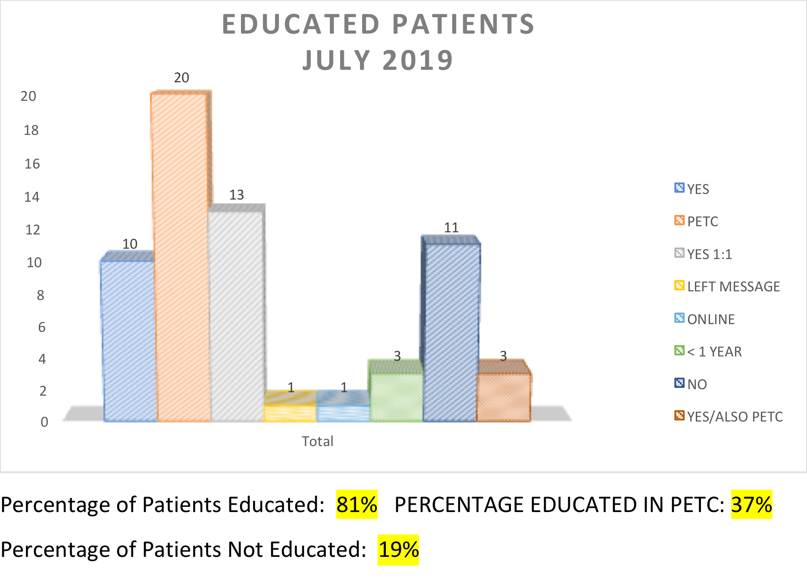
Passavant July 2019

Slide 22
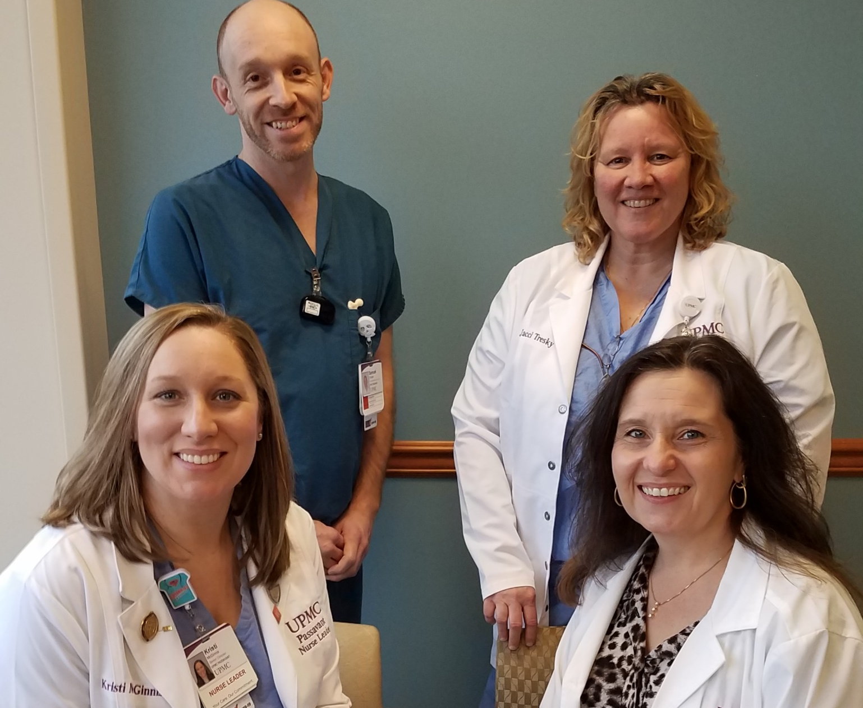
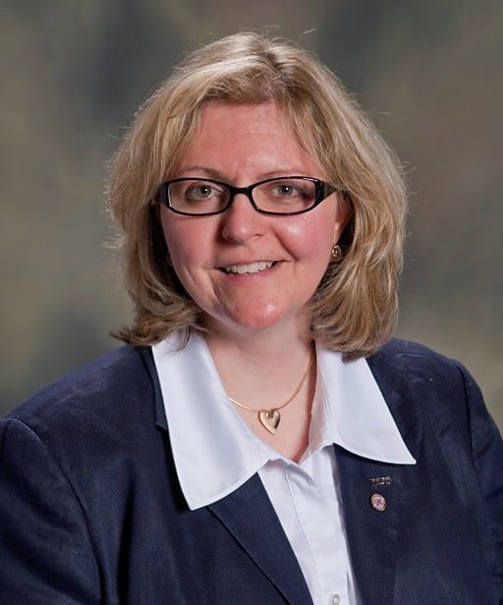
Passavant July 2019
Percent Discharged Home: 84%
Percent Discharged to SNF: 15%
Percent Discharged IPR: 1%
Same Day Patients: 2
One day Patients: 25
ALOS CJR: 1.71
Kristi McGinnis, OR Clinician
Sam Chilcote, Ortho Tech
Cyndie Cypher, Physician Assistant
Lisa Saylor, OP Nurse Coordinator
Pamela Cupec, Orthopedic Nurse Navigator

Slide 23
Short stay total joint arthroplasty
    Safe
    Benefits all parties
      Patients, hospitals, insurance carriers, surgeons
    Necessary to deliver safe efficient care as the demand grows
    Progress in TJA
    Can be done effectively with a team approach
      Patient education
      Pre-operative optimization
      ERAS
      Multimodal pain management
      Great physical therapy team

Slide 24
Thank You

