Slide 1
Same Day Discharge Following Joint Surgery
Brian A. Klatt, MD
University of Pittsburgh Department of Orthopaedic Surgery

Slide 2
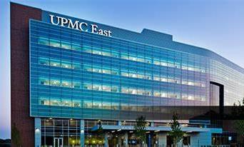
Same Day Discharge
Patients are sent home on day of hip and knee replacement
This statement was a provocative statement about 15-20 years ago
Now safe and supported with research
Several Center of Excellence facilities offer this at UPMC

Slide 3
Same Day Discharge
Our same day hips and knees have done well.
Recent publication - 2019 – but compares data all the way to 2005
Early patients without TXA, aspirin
High ASA grades (3,4) were included – ASA 1,2 only for us
Hospital based data only
Many patients are now having this done at ASCs

Slide 4
Why Same Day Discharge?
Patients want to go home
Comfort
Patient satisfaction
Convenience
Cost reduction
Driven by insurance and government
CMS – removed knee replacement from Inpatient Only List (IPO), hip replacement is next!

Slide 5
What is different with these patients?
Patient selection
Patient motivation
Protocol very similar to all other joint replacements
We do the best for everyone
Set expectations/educate
Early surgery to allow time for recovery

Slide 6
Does surgical technique matter?
Surgical approach seems less important than efficient surgery with minimizes soft tissue trauma.
Direct anterior
Watson jones
Anterolateral
Posterior
2 incision
Surgeons are marketing approach
Robots have been marketed for unis with the promise of faster recovery. This seems to be purely marketing

Slide 7
Success at Same Day Discharge
Patient selection
Screening
Optimization
Preparation
Education
Apps
Team engaged in process

Slide 8
Success at Same Day Discharge
Protocols
Anesthesia
Pain
Therapy
Blood preservation
Clot prevention
Hydration
Support (team)
Contact
Timing
Done early in the week

Slide 9
Literature
2017 – randomized, prospective study
This study provides guidelines to develop a safe outpatient hip and replacement program – we have used same criteria for knee
Average age 60 in this study
24% of those planned for outpatient were not able to leave on day of surgery – overnight facilities need to be available.

Slide 10
Patient selection
Unilateral
ASA Grade I or II
Pre-operative BMI <35
Age <75 years at the time of surgery
Normal pre-op hemoglobin
No CAD that would require monitoring post-op
Pre-op not using walker or wheelchair
No chronic pre-op opioid meds or opioid addiction

Slide 11
Patient selection
Family involved/safe home
Travel from hospital no more than 1.5 hrs
No other condition or circumstance that would interfere with SDS
Patient motivated
Uncontrolled sleep apnea – pulmonary issues

Slide 12
Optimization – should be done for all
Center for pre-operative optimization
Shadyside
Central testing
Center of Excellence process
Coordinated at facility where surgery will be done
Testing done 3-4 weeks before surgery to allow for correction of issues

Slide 13
Optimization – should be done for all
Center for pre-operative optimization at Shadyside will assist
Diabetes – poorly controlled = infection
Body weight – too high or too low
Dental care
Nutrition – wound healing
Blood Count (correct anemia) – decreases transfusion risk
Decolonize body from bacteria (MRSA/MSSA)
Smoking – wound healing poor
General health must be optimized
Muscle strength – pre-hab

Slide 14
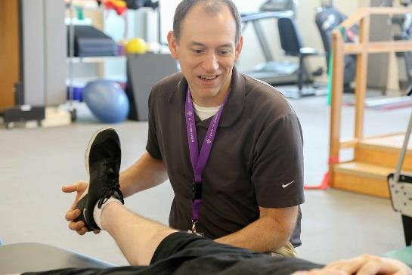
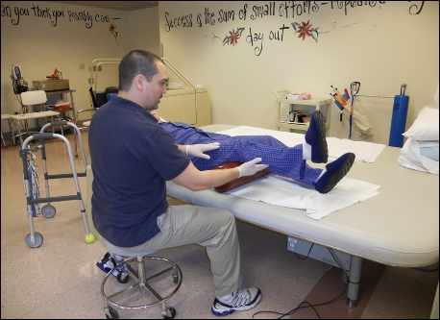
Preparation
Pre-op class
Set expectations
Engage family/care givers
Physical Therapy
Prehabilitation
Start doing exercises so that patients understand post-op

Slide 15
Preparation
Apps
Iphone pathways to provide education before surgery and keep patient moving along towards completing preparations
We are starting a research protocol with Zimmer and a new Iphone/watch app that will guide through surgery
Team engagement
Every member of team needs to reinforce and encourage success
Office, PT, nurses, nursing aids, anesthesia
Becomes infectious and exciting to see the patient’s succeed

Slide 16
Protocols
Anesthesia
Spinal is preferred; short acting
Avoid IV narcotics
Multimodal
Pain
Nerve blocks
Peri-capsular injections
Avoid IV narcotics
Multimodal pain control

Slide 17
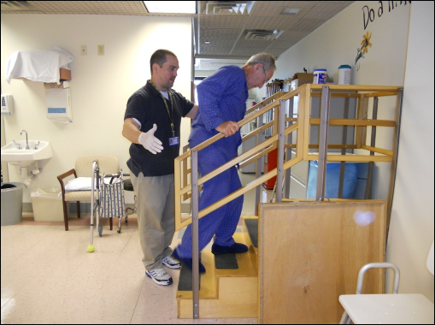
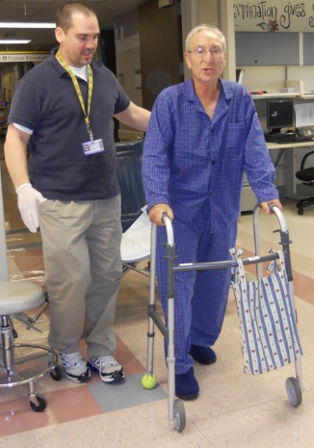
Protocols
Therapy
Prehab
Weight bearing as tolerated
No precautions
Do at ASC, PACU or in Rehab unit
Blood preservation
Never go ahead with low Hemoglobin
Tranexamic acid (TXA) – oral – 2 doses
Transfusion rates are 1%

Slide 18
Protocols
Clot prevention
81 mg aspirin
Mobilization
Therapy
ERAS (enhanced recovery after surgery)
Clear liquids until 3 hrs before surgery
Liberal use of hydration
Includes anesthesia

Slide 19
Protocols
Urinary retention
Avoid catheters – void pre-op
Encourage standing to void for men and toilet use for women
Avoid medications that cause retention
Anticipate urinary retention in men with BPH – make certain this is treated pre-op

Slide 20
Making home successful
Discharge instructions
Crucial that they got education pre-op
Reinforce
Meds to beds if available – they will not be hunting for meds
Support (team)
Office needs to be available and will to contact, see in office as needed
Contact – DAS contacts on POD #1
PA contacts on POD #3
Timing
Done early in the week

Slide 21
Starting same day program
Evolution – not revolution
Get involved in Center of Excellence (COE) process and standardization
Identify possible candidates and work on the process
Transition to Ambulatory Surgical Center (ASC)
Need short stay option available – ie hotel
Instrument processing
Many say this is easier than working from hospital for same day

Slide 22
Thank You

